Slide 1
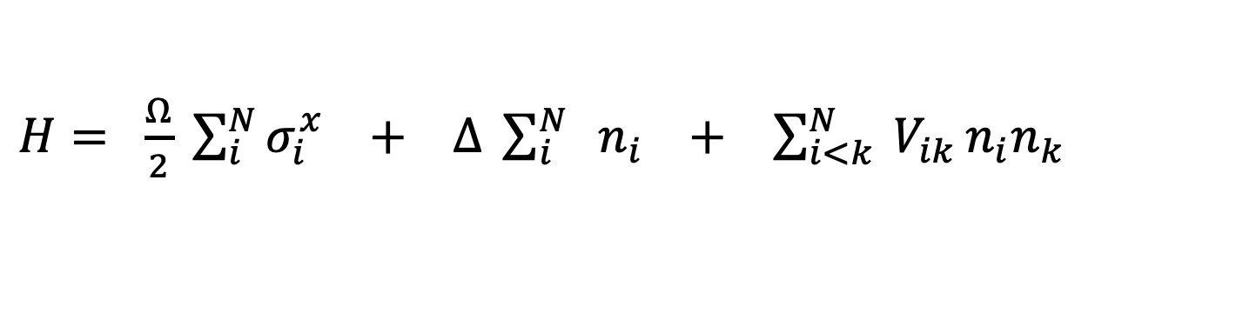
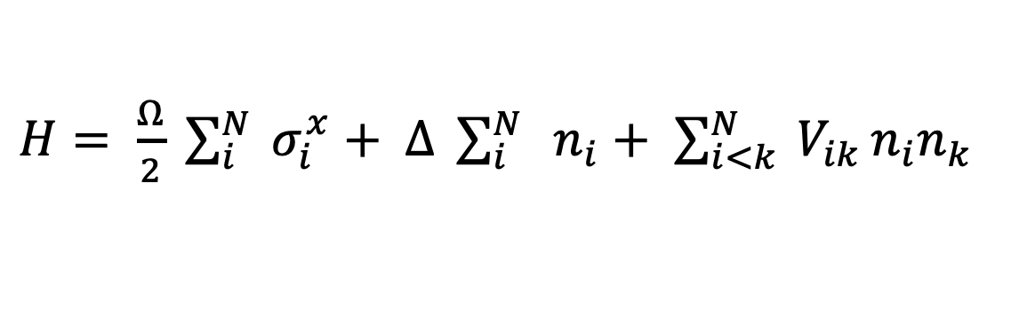
$H= \frac{Ω}{2} \sum_{i}^{N}{{ σ}_{i}^{x}}+$ $∆ \sum_{i}^{N}{ { n}_{i}}$ $+$ $\sum_{i<k}^{N}{ V_{ik}}n_{i}n_{k}$
$H= \frac{Ω}{2} \sum_{i}^{N}{σ_{i}^{x}} +$ $∆ \sum_{i}^{N}{ { n}_{i}}$ $+$ $\sum_{i<k}^{N}{ V_{ik}}n_{i}n_{k}$

Slide 2
|r⟩
Δ
Ω
|0⟩

Slide 3



Rydberg
Blockade
$$Ω_{0}$$
$${2 Ω}_{0}$$
$$Ω_{0}$$

Slide 4

Rydberg
Blockade
$$Ω_{0}$$
$$\sqrt{2}{ Ω}_{0}$$
$${2 Ω}_{0}$$
$$Ω_{0}$$

Slide 5
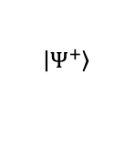
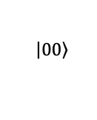
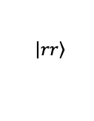
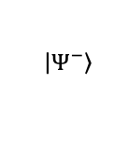
$$\left|\left.00\right\rangle \right.$$
$$\left|\left.Ψ^{−}\right\rangle \right.$$
$$\left|\left.Ψ^{+}\right\rangle \right.$$
$$\left|\left.rr\right\rangle \right.$$

